Slide 1
LECTURE TWO
COST –VOLUME-PROFIT ANALYSIS
“BREAK EVEN ANALYSIS”
© 2020 McGraw-Hill Education. All rights reserved. Authorized only for instructor use in the classroom. No reproduction or further distribution permitted without the prior written consent of McGraw-Hill Education.
Notes:
Chapter 6: Cost-Volume-Profit Analysis
Cost-volume-profit (CVP) analysis is a decision-making tool that focuses on the relationship among the volume and mix of units sold, prices, variable costs, fixed costs, and profit. The CVP framework allows managers to evaluate how changing one or more of these key variables will impact profitability, while holding everything else constant.

Slide 2
Contribution Margin Income Statement
Contribution margin is the difference between sales revenue and variable costs.
Access the text alternative for slide images
Notes:
A contribution margin income statement categorizes costs based on whether they are variable or fixed. Unlike financial statements meant for external users, which are prepared according to GAAP, a contribution margin income statement is used only for internal purposes.
The contribution margin represents the amount of sales revenue left to contribute toward fixed costs and profit after variable costs have been covered. In this example, the total contribution margin earned on 15,000 units sold is $22,500 ($37,500 sales revenue – $15,000 variable costs). When the fixed costs of $12,000 are subtracted, the net operating income is $10,500.

Slide 3
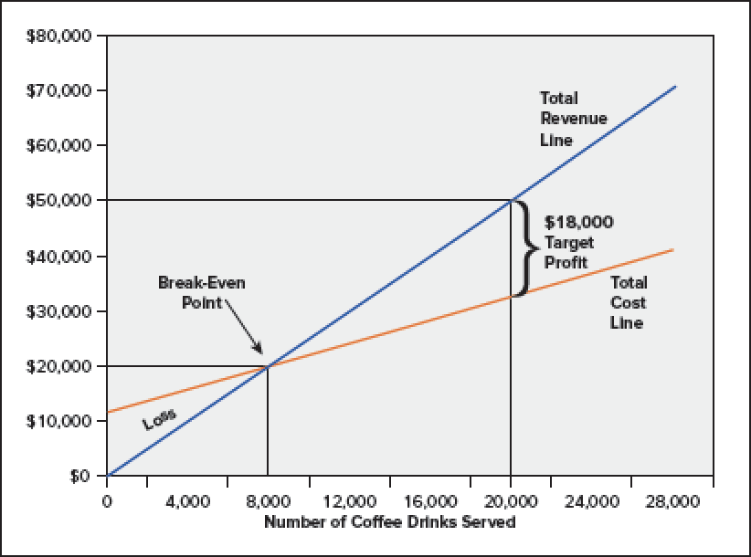
Cost-Volume-Profit in Graph
Access the text alternative for slide images
Notes:
Below the break-even point, we see losses, and above the break-even point, we see profits.
If Starbucks sells 20,000 cups of coffee, it will earn a target profit of $18,000. Total revenue will be $50,000 (20,000 cups times $2.50 per cup), total variable costs will be $20,000 (20,000 cups times $1.00 per cup), and fixed costs will be $12,000. So total revenue will be $50,000 and total costs will be $32,000 ($20,000 plus $12,000) resulting in a target profit of $18,000.

Slide 4
COST_VOLUME _PROFIT ANALYSIS Break- Even Analysis
Total sales revenue − Total variable cost − Total fixed costs = Profit
(Unit price × Q) − (Unit variable costs × Q) − Total fixed costs = Profit
Q = Quantity of unit sold
To find the break-even point, we simply set the profit equation equal to zero, and solve for the quantity of units (Q).
(Unit price × Q)−(Unit variable costs × Q) − Total fixed costs = Profit
($2.50× Q) − ($1.00 × Q) − $12,000 = 0
$1.50Q = $12,000
Q = $12,000 ÷ $1.50
Q = 8,000 units
{8000x2.5} – {8000x1}=12000-12000=0
OR By Formula = Total Fixed Cost = 12000 = 8000 units
CM/unit 1.5
Notes:
Sales 8000 x 2.5 =20000
TVC 8000x1 = 8000
=TCM 12000
TFC (12000)
Income 0
At BEP = sales 20,000 = (TVC 8000 +12000]
No profit No loss
TCM = TFC
The profit equation defines profit as the difference between total sales revenue and total fixed and variable costs.
Total sales revenue and variable costs are a function of the number of units sold (Q), while total fixed costs are independent of the number of units sold. In CVP analysis, we allow any single factor in the equation to vary, while holding everything else constant, to determine the ultimate effect on profit. We have restated the basic equation at the top of your screen to include the components of total sales revenue (unit price x quantity sold) and total variable costs (unit variable costs x quantity sold). To find the break-even point, we simply set the profit equation equal to zero, and solve for the quantity of units (Q).
Using the information from our prior example, we know that the sales price is $2.50 per unit, the unit variable costs are $1 and the total fixed costs are $12,000. When we use these numbers in the profit equation, we get that $1.50Q = $12,000. We then solve for Q of 8,000 units.

Slide 5
Break-even in Dollar Sales: Formula Method
Now, let’s use the formula method to calculate the dollar sales at the break-even point.
Dollar sales to break even
Fixed expenses
CM ratio
=
$12,000
60%
Dollar sales =
Dollar sales = $20,000
Notes:
BEP in units = TFC 12000 = 8000u BE Dollar 8000x 2.5=20000
CM/unit 1.5
12000 =20000
60%
You can see that if we elect to use the formula method, we calculate the same sales of $200,000 at the break-even point.

Slide 6
Quick Check ✓
Coffee Klatch is an espresso stand in a downtown office building. The average selling price of a cup of coffee is $1.49 and the average variable expense per cup is $0.36. The average fixed expense per month is $1,300. An average of 2,100 cups are sold each month. What is the break-even sales dollars?
a. $1,300
b. $1,715
c. $1,788
d. $3,129
Notes:
Let’s calculate the break-even in sales dollars for Coffee Klatch
1.CM/unit = SP- VC = 1.49-0.36= $1.13 /unit
BEP in units= TFC/CM/unit x SP= BEP $
1300/1.13= 1150.4 unitsx1.49= $1714.15
2. CM Ratio = CM/SP 1.13/1.49=75.83%
BEP in $ = TFC/CM% 1300/75.83% =1714.15
2100x1.49 BEP$
[1150 x 1.49 – 1150 x0.36] -1300= 0.5 MOS= 2100-1150=950units OR $ 3129 - 1715=$1414
CM/unit = 1.49-0.36= 1.13 FC/CM%
1300/1.13= 1150.4 units
BEP in dollars= 1150.4 X1.49=1715
CM %= 1.13/1.49= 75.83%
BEP in dollars = 1300/75.83%= 1715
0= 1.49Q- 0.36Q- 1300
1300= 1.13Q

Slide 7
Quick Check ✓
Coffee Klatch is an espresso stand in a downtown office building. The average selling price of a cup of coffee is $1.49 and the average variable expense per cup is $0.36. The average fixed expense per month is $1,300. An average of 2,100 cups are sold each month. What is the break-even sales dollars?
a. $1,300
b. $1,715
c. $1,788
d. $3,129
Break-even sales
Fixed expenses
CM Ratio
=
$1,300
0.758
=
= $1,715
Notes:
With a contribution margin ratio of 75.8% (rounded), break-even sales revenue is $1,715.

Slide 8
Quick Check ✓
Coffee Klatch is an espresso stand in a downtown office building. The average selling price of a cup of coffee is $1.49 and the average variable expense per cup is $0.36. The average fixed expense per month is $1,300. An average of 2,100 cups are sold each month. What is the break-even sales in units?
a. 872 cups
b. 3,611 cups
c. 1,200 cups
d. 1,150 cups
Notes:
Now use the contribution margin approach to calculate the break-even point in cups of coffee sold.

Slide 9
Quick Check ✓
Coffee Klatch is an espresso stand in a downtown office building. The average selling price of a cup of coffee is $1.49 and the average variable expense per cup is $0.36. The average fixed expense per month is $1,300. An average of 2,100 cups are sold each month. What is the break-even sales in units?
a. 872 cups
b. 3,611 cups
c. 1,200 cups
d. 1,150 cups
Fixed expenses
CM per Unit
Break-even =
$1,300
$1.49/cup - $0.36/cup
=
$1,300
$1.13/cup
=
= 1,150 cups
Notes:
The contribution margin per cup of coffee is $1.13. The number of cups to sell to reach break-even is 1,150.

Slide 10
Target Profit Analysis
Assume that the target profit was $18,000.
Target Profit Analysis
(Unit price × Q) − (Unit variable costs × Q) − Total fixed costs = Profit
($2.50 × Q) − ($1.00 × Q) − $12,000 = $18,000
$1.50 Q = $30,000
Q = (12000+18000)/1.5
Q = 20,000 units

Slide 11
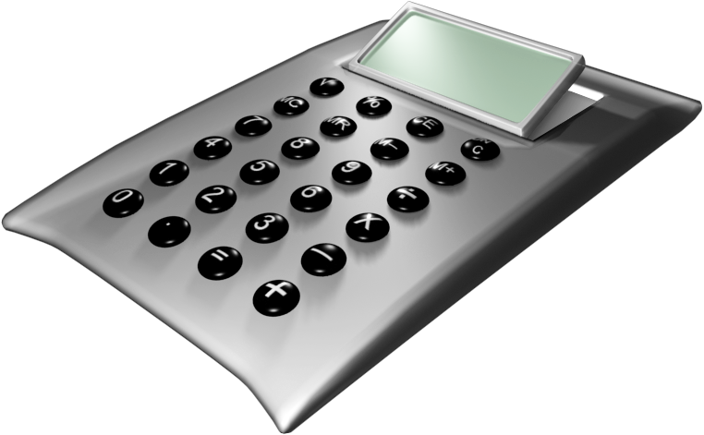
The Formula Method
The formula uses the following equation.
Unit sales to attain the target profit
Target profit + Fixed expenses CM per unit
=
Notes:
Target profit is expressed in units sold. For this equation we divide the sum of the desired target profit plus total fixed expenses by the contribution margin per unit.

Slide 12
Target Profit Analysis in Terms of Unit Sales
Suppose that the Company wants to know how many units must be sold to earn a profit of $18,000.
Unit sales to attain the target profit
Target profit + Fixed expenses CM per unit
=
$18,000 + $12,000
$1.5
Unit sales =
Unit sales = 20000
Notes:
Suppose Racing Bicycle Company wants to earn net operating income of $100,000. How many bikes must the company sell to achieve this profit level? Let’s use the formula method.
Unit sales to attain the target profit level is equal to the sum of $100,000 (the target profit) plus $80,000 (total fixed expenses) divided by the unit contribution margin of $200. We arrive at 900 units sold to earn net operating income of $100,000.

Slide 13
Formula Method
We can calculate the dollar sales needed to attain a target profit.
Dollar sales to attain the target profit
Target profit + Fixed expenses
CM ratio
=
$18,000 + $12,000
60%
Dollar sales =
Dollar sales = $50,000
Notes:
The formula method is summarized on this slide. It can also be used to compute the dollar sales needed to attain a target profit. Study the equation in the box on your screen.
Suppose RBC wants to compute the dollar sales required to earn a target profit of $100,000. The formula method can be used to determine that sales must be $450,000 to earn the desired target profit.

Slide 14
Quick Check ✓
Coffee Klatch is an espresso stand in a downtown office building. The average selling price of a cup of coffee is $1.49 and the average variable expense per cup is $0.36. The average fixed expense per month is $1,300. Use the formula method to determine how many cups of coffee would have to be sold to attain target profits of $2,500 per month.
a. 3,363 cups
b. 2,212 cups
c. 1,150 cups
d. 4,200 cups
Notes:
The Coffee Klatch wants to earn a monthly profit of $2,500. How many cups of coffee must the company sell to reach this profit goal?
1300+2500
1.13

Slide 15
Quick Check ✓
Coffee Klatch is an espresso stand in a downtown office building. The average selling price of a cup of coffee is $1.49 and the average variable expense per cup is $0.36. The average fixed expense per month is $1,300. Use the formula method to determine how many cups of coffee would have to be sold to attain target profits of $2,500 per month.
a. 3,363 cups
b. 2,212 cups
c. 1,150 cups
d. 4,200 cups
Unit sales to attain target profit
Target profit + Fixed expenses
Unit CM
=
$2,500 + $1,300
$1.49 - $0.36
=
$3,800
$1.13
=
= 3,363 cups
Notes:
We add the desired profit to the fixed cost and divide by the unit contribution of $1.13. The company must sell 3,363 cups of coffee to reach its profit goal.

Slide 16
Quick Check ✓
Coffee Klatch is an espresso stand in a downtown office building. The average selling price of a cup of coffee is $1.49 and the average variable expense per cup is $0.36. The average fixed expense per month is $1,300. Use the formula method to determine the sales dollars that must be generated to attain target profits of $2,500 per month.
a. $2,550
b. $5,013
c. $8,458
d. $10,555
Notes:
The Coffee Klatch wants to earn a monthly profit of $2,500. How many sales dollars must be generated to attain the target profit level?

Slide 17
Quick Check ✓
Coffee Klatch is an espresso stand in a downtown office building. The average selling price of a cup of coffee is $1.49 and the average variable expense per cup is $0.36. The average fixed expense per month is $1,300. Use the formula method to determine the sales dollars that must be generated to attain target profits of $2,500 per month.
a. $2,550
b. $5,013
c. $8,458
d. $10,555
Sales $ to attain target profit
Target profit + Fixed expenses
CM ratio
=
$2,500 + $1,300
($1.49 – 0.36) ÷ $1.49
=
$3,800
0.758
=
= $5,013
Notes:
We add the desired profit to the fixed cost and divide by the contribution margin ratio (.758). The company must generate sales of $5,013 in order to reach its target profit of $2,500.

Slide 18
Margin of Safety
Margin of safety is the difference between actual or budgeted sales and the break-even point.
It equals
Actual or Budgeted Sales − Break-Even Sales =
Notes:
The margin of safety is the difference between actual or budgeted sales and the breakeven point. Think of the margin of safety as a buffer zone that identifies how much sales can drop before the business will suffer a loss. This application of CVP analysis is most relevant to companies that face a significant risk of not making a profit, such as start-up businesses or companies that face extreme competition or abrupt changes in demand.

Slide 19
Margin of Safety
Access the text alternative for slide images
Notes:
20,000 – 8000 =CM 12000 – FC12000= 0
+17500 x 60% 10500
= 37500
Let’s assume that our hypothetical Starbucks coffee location operated above the break-even point during February with sales of $37,500. During the month, the company reported a profit of $10,500. Let’s calculate Starbucks’ margin of safety.
Recall that the break-even point was 8,000 units, or $20,000 in total sales. Subtracting $20,000 from Starbucks’ actual sales of $37,500, we find that Starbucks’ margin of safety in dollars is $17,500.

Slide 20
Multi-Product Cost-Volume-Profit Analysis
Product mix is the relative mix of products or services stated in terms of the number of units sold.
The product mix is used to compute the weighted-average contribution margin per unit.
Sales mix is the relative mix of products or services as a percentage of total sales revenue.
The sales mix is used to compute the weighted-average contribution margin ratio
Notes:
In the previous examples, we simplified the CVP analysis by assuming that Starbucks sells only one type and size of coffee drink. But we all know that Starbucks, and most other businesses, offer more than one product or service. For example, Starbucks sells coffee, tea, pastries, sandwiches, salads, mugs, T-shirts, and other novelty items. Each of these items is likely to have a different price and unit cost, which makes the CVP analysis more complex.
The key to performing CVP analysis in a multiproduct setting is to make an assumption about the relative mix of products or services sold. The mix can be stated in terms of the number of units sold (called the product mix) or as a percentage of total sales revenue (called the sales mix). The product mix is used to compute the weighted-average contribution margin per unit, while the sales mix is used to compute the weighted-average contribution margin ratio, or contribution margin as a percentage of sales. Either of these numbers can be used for multiproduct cost-volume-profit analysis, including break-even or target profit analysis. Which method you use depends on how the information is presented and whether you are trying to solve for the number of units or total sales revenue. As with the single-product scenarios, both methods will yield the same answer as long as you have complete information about unit sales prices. The only caveat is that the analysis will be valid only for the assumed product or sales mix.

Slide 21
Weighted-Average Contribution Margin Ratio
We can also do multiproduct CVP analysis by using the sales mix (stated in terms of total sales dollars) to compute the weighted-average contribution margin ratio.
This approach is commonly used in business because managers often have aggregated information about revenue and costs by product line.
Notes:
We can also do multiproduct CVP analysis by using the sales mix (stated in terms of total sales dollars) to compute the weighted-average contribution margin ratio. This approach is commonly used in business because managers often have aggregated information about revenue and costs by product line (as opposed to the detailed information about prices, quantities, etc.)

Slide 22
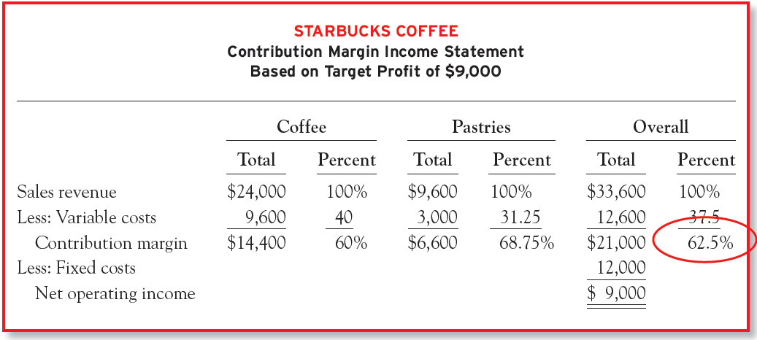
Weighted-Average Contribution Margin Ratio
Access the text alternative for slide images
Notes:
BEP = 12000/62.5%= 19200
Coffee = 24000/33600 x 19200=$13714
Pastries= 9600/33600 x 19200 =$5486
Consider the following contribution margin statement for Starbucks. This is the same income statement we just prepared for a target profit of $9,000, but the numbers have been restated as a percentage of total sales revenue. The weighted-average contribution margin ratio reflects the contribution margin ratios of the two products weighted according to the relative percentage of total sales revenue.
In this example, the sales mix is 71.43 percent ($24,000 ÷ $33,600) from coffee and 28.57 percent ($9,600 ÷ $33,600) from pastries. The sales mix is based on total sales revenue (dollars) not units. The 62.5 percent ($21,000/$33,600) means overall or weighted-average contribution margin ratio that every dollar of sales revenue will generate an average of $0.625 in contribution margin. But this number only holds if the sales mix is 71.43 percent coffee and 28.57 percent pastries.
Managers can use the 62.5 percent weighted-average contribution margin ratio to determine how much total sales revenue is needed to break even or earn a target profit.

Slide 23
Weighted-Average Contribution Margin Ratio
Assume that the Starbucks’ manager wants to earn a target profit of $15,000
Notes:
Assume that the Starbucks’ manager wants to earn a target profit of $15,000. Given the assumed sales mix, what is the total sales revenue needed to achieve this target profit?
To answer this question, we can use the target sales formula, with the weighted-average contribution margin ratio as the denominator. To determine how much of the $43,200 ($12,000 + $15,000)/62.5%) in target sales revenue must come from each product line, we multiply by the assumed sales mix. Notice that we used the total sales mix (not the unit sales mix) to determine how much of the total sales revenue must come from coffee and pastries. Remember that the 62.5% weighted-average contribution margin ratio was weighted according to the sales mix, not the product mix. Coffee sales would need to be $30,858 ($43,200 x 71.43%) and pastry sales would need to be $12,342 ($43,200 x 28.57%)
The most important thing to remember when performing cost-volume-profit analysis in a multiproduct setting is to assume and maintain a constant product or sales mix. The mix can be stated in terms of the number of units sold or as a percentage of total sales revenue. The only difference between the two is the unit sales price (which is excluded from the product mix but included in the sales mix). Either approach provides the same end result.

Slide 24
Weighted-Average Contribution Margin per Unit
 | Footballs | Basketballs
Sales price per unit | $100 | $120
Variable costs per unit | 70 | 85
Contribution margin per unit | $ 30 | $ 35
Sales mix percent | 60% | 40%
Learning Objective P3: Compute the break-even point for a multiproduct company.
Notes:
When a mix of products is sold, break-even can be computed with a weighted-average contribution margin per unit. This measure combines the per unit contribution margins of each product by their weights in the sales mix. To demonstrate, assume Rydell expands its product line to include basketballs. It adds another production shift, increasing its fixed costs to $48,000. Information for the two products is in Exhibit 21.26.
Using the data in Exhibit 21.26, the weighted-average contribution margin is computed as $32 per unit as shown in exhibit 21.27.

Slide 25
Weighted-Average Break-Even in Unit Sales
Product | Break-Even Units × Sales Mix | Unit Sales | Contribution Margin per Unit | Contribution Margin
Footballs | 1,500 × 60% | 900 | $30 | $27,000
Basketballs | 1,500 × 40% | 600 | 35 | 21,000
Total |  | 1,500 |  | $48,000
Learning Objective P3: Compute the break-even point for a multiproduct company.
Notes:
When a mix of products is sold, break-even can be computed with a weighted-average contribution margin per unit. This measure combines the per unit contribution margins of each product by their weights in the sales mix. To demonstrate, assume Rydell expands its product line to include basketballs. It adds another production shift, increasing its fixed costs to $48,000. Information for the two products is in Exhibit 21.26.
Using the data in Exhibit 21.26, the weighted-average contribution margin is computed as $32 per unit as shown in exhibit 21.27.

Slide 26
Degree of Operating Leverage (DOL)
Operating leverage is concerned with changes in cost structures. It measures the extent to which fixed costs are used to operate the business. In general, high fixed costs indicate that a company is highly leveraged.
DOL is a multiplier we can use to predict how a percentage change in sales revenue will translate into a percentage change in profit
Notes:
Degree of operating leverage measures the extent to which fixed costs are used to operate the business. In general, high fixed costs indicate that a company is highly leveraged.
Recall that fixed costs are subtracted from contribution margin to calculate net operating income (profit). If fixed costs are zero, contribution margin (numerator) and net operating income (denominator) are equal, resulting in a degree of operating leverage of one. A degree of operating leverage greater than one means that managers are using fixed costs for some operations. Fixed costs do not change with volume; as a result, a degree of operating leverage greater than one means that a given change in sales volume will impact profit to a larger degree.

Slide 27
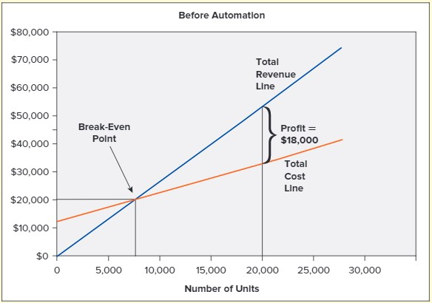
Changes in Cost Structure
Automation increases the break-even point because fixed costs are higher. But each unit adds more profit because of the lower variable cost per unit.
Access the text alternative for slide images
Notes:
At less than 20,000 units, profit is higher before automation.

Slide 28
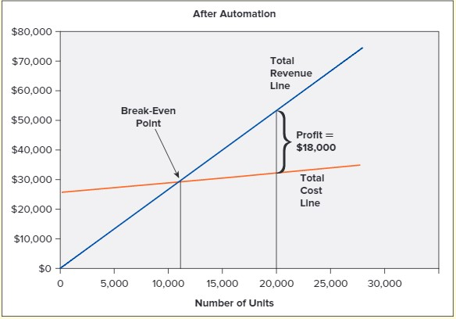
Changes in Cost Structure
Access the text alternative for slide images
Notes:
Automation increases the break-even point because fixed costs are higher. But each unit adds more profit because of the lower variable cost per unit. Profit is the same at 20,000 units. As long as the manager expects demand to exceed 20,000 units per month, the investment in automation should result in increased profit. However, there is a greater risk with automation in the event that demand is not as large as expected. This risk is reflected in a measure called degree of operating leverage.

Slide 29
EXAMPLE
. In this example, if sales revenue increases by 10%, profit will increase by 16.7% without automation or 24.4% with automation.
 | (No Automation) Base Case | (No Automation) 10 Percent Increase | (Automation) Base Case | (Automation) 10 Percent Increase
Sales revenue | $50,000 | $55,000 | $50,000 | $55,000
Less: Variable costs | 20,000 | 22,000 | 6,000 | 6,600
Contribution margin | $30,000 | $33,000 | $44,000 | $48,400
Less: Fixed costs | 12,000 | 12,000 | 26,000 | 26,000
Net operating income | $18,000 | $21,000 | $18,000 | $22,400
Notes:
Sales +10% Profits +16.7% 1.67 times
Sales +10% +24.4% 2.4 times
The degree of operating leverage is a multiplier that we can use to predict how a percentage change in sales revenue will translate into a percentage change in profit. In this example, if sales revenue increases by 10 percent, profit will increase by 16.7 percent (10% × 1.67) without automation or 24.4 percent (10% × 2.44) with automation.
Keep in mind that operating leverage works in both directions. It magnifies the effect of both increases and decreases in sales revenue. If sales decrease by 10 percent, the company will experience a more dramatic decline in profit with automation than without it. In general, a company with a high degree of operating leverage (high fixed costs) will experience greater swings in profit as a result of changes in sales revenue and is therefore considered riskier than a comparable company with a smaller degree of operating leverage. In making choices about cost structure, managers must consider both the rewards (potential for increased profit) and amount of risk (upside and downside) they are willing to bear.

Slide 30
Degree of Operating Leverage
Let's see how the trade-off of fixed and variable costs (through automation) affected Starbucks’ degree of operating leverage. We will use the indifference point of 20,000 cups sold.
 | 20,000 Units sold (No Automation) Per Unit | 20,000 Units sold (No Automation) Total | 20,000 Units sold (Automation) Per Unit | 20,000 Units sold (Automation) Total
Sales revenue | $2.50 | $50,000 | $2.50 | $50,000
Less: Variable costs | 1.00 | 20,000 | 0.30 | 6,000
Contribution margin | $1.50 | $30,000 | $2.20 | $44,000
Less fixed costs |  | 12,000 |  | 26,000
Net operating income |  | $18,000 |  | $18,000
Notes:
Let’s see how the trade-off of fixed and variable costs (through automation) affects Starbucks’ degree of operating leverage. As a starting point, we use the indifference point of 20,000 units so that sales revenue and profit will be the same in both scenarios.
Although profit is the same at 20,000 units, the degree of operating leverage is higher with automation 2.44 ($44,000/$18,000) than without it, 1.67($30,000/$18,000). The reason is that automation requires an investment in fixed costs.

Slide 31
INDIFFERENT POINT
Notes:
So, the profit equation before automation must equal the profit equation after automation.
$2.50Q -$1.00Q - $12,000 = $2.50Q - $0.30Q - $26,000, when we solve for Q we determine that at a sales volume of 20,000 units, the company will make the same profit with or without automation. If volume is more than 20,000 units, the company will make a higher profit with the automated ordering system. But if volume is less than 20,000 units per month, profit will be higher without automation.

